Slide 1



OFFICE NETWORK SIMULATION Cisco Packet Tracer
Presented by = Khawaja Azfar Asif-023
Muhammad Kashir Khan- 008
Muhammad Asad Khan- 036
Presented to = Sir Rafaqat Alam Khan

Slide 2


Table of Contents
01
Office Layout
02
Items Uses
04
Office Section
Network Topology
03
05
Software Use

Slide 3
01
Office Layout

Slide 4
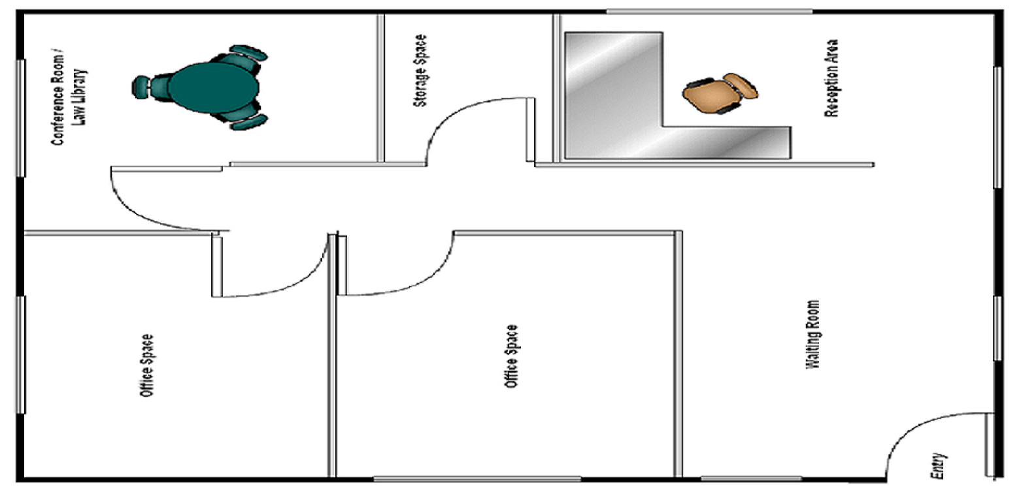

Slide 5
02
Network Topology

Slide 6
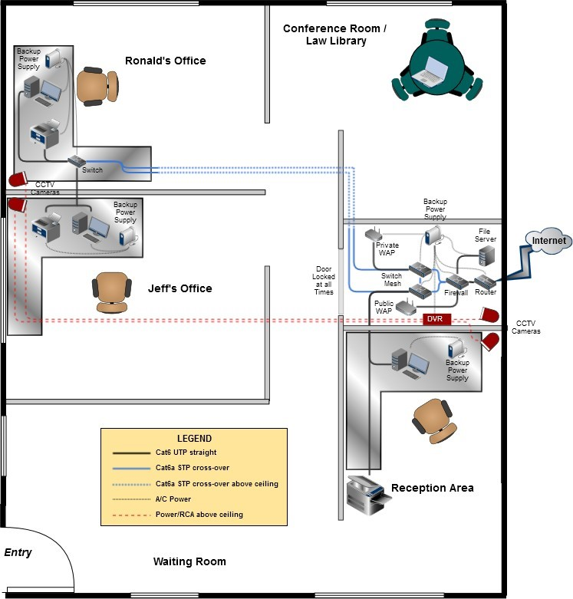

Slide 7
03
Items Used

Slide 8

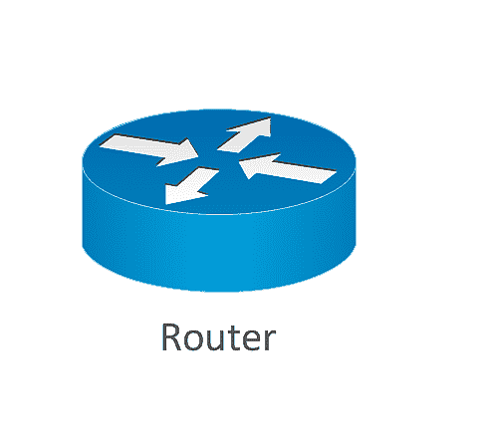








Following are items Uses
Router
Switches
Cables
CCTV Camera
DVR for Camera
PC
Laptop
Printer
Smartphones
Servers

Slide 9
04
Office Section

Slide 10
Following are Sections of Office
Reception
Conference Room
Server Room
Ronald’s Room
Jeff’s Room

Slide 11
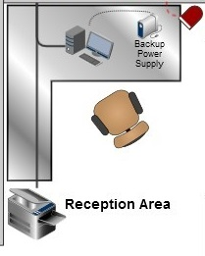
1.Reception

Slide 12
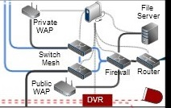
2.Server Room

Slide 13
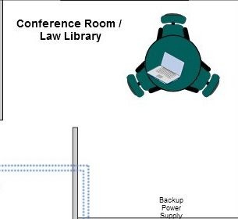
3.Conference Room

Slide 14
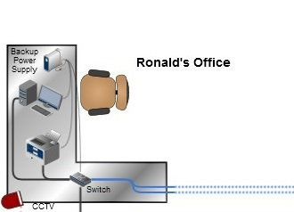
4.Ronald’s Room

Slide 15
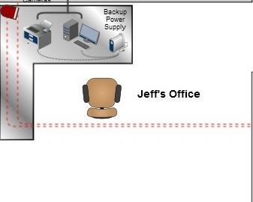
5.Jeff’s Room

Slide 16
05
Software Use

Slide 17

For this Project We use Cisco Packet Tracer

Slide 18


Slide 19


